Slide 1
Logistic Regression (Maximum Entropy Model)
NLP II 2025 Attapol Thamrongrattanarit รศ. ดร.อรรถพล ธำรงรัตนฤทธิ์

Slide 2
Text Classification
Text classification is the task of assigning predefined categories or labels (output) to a given piece of text (input), which can be a sentence, a document, or a set of documents.

Slide 3
😣
Text input
"อาหารเหมาะสำหรับสัตว์เลี้ยงเท่านั้น"
"ไกลแค่ไหนก็ต้องมาทาน"
...
"พนักงานบริการเต็มใจมาก"
😀
😐
Predefined categories or labels
Sentiment Analysis

Slide 4


OK
Text input
"ชื่นชอบผลงานมานานแล้วค่ะ"
"เงินกู้ด่วน ไม่ต้องค้ำ ดอกเบี้ยต่ำ คลิกเลย"
"ถ้าจะเต้นแค่นี้ กลับบ้านเหอะ เซ็ง"
...
"เพลงน่าจะชัดกว่านี้ค่ะ แต่เต้นเป๊ะมาก"
Predefined categories or labels
Spam classification

Slide 5
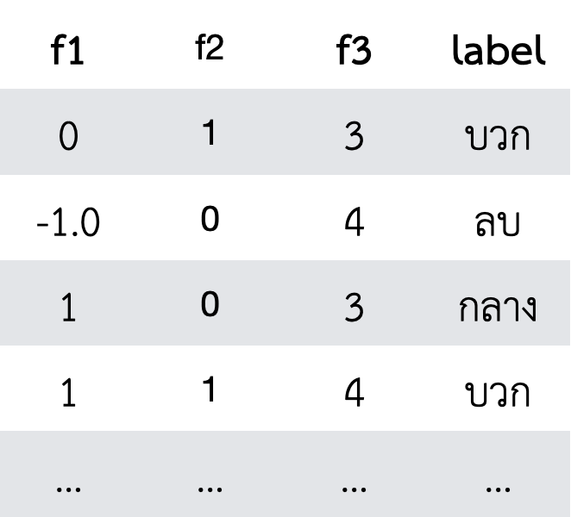


4 Steps for Supervised Learning
Input | Output
"อาหารเหมาะสำหรับสัตว์เลี้ยงเท่านั้น" | 😣
"ไกลแค่ไหนก็ต้องมาทาน" | 😀
... | ...
"พนักงานบริการเต็มใจมาก" | 😣
Data preparation | Feature engineering | Model training | Evaluation

Slide 6
How make a good classifier
Domain: The data must match the real scenario.
Data quality and quantity: The annotation must be consistent, and the size must be large.
Feature engineering: What does the model need to pay attention in order to make a good decision?
Model: Some models are better than others.

Slide 7
Logistic Regression

Slide 8
Logistic Regression
Logistic regression (or Maximum Entropy Model) is a statistical model that computes P(Y|X) from a linear combination of input features. It models a link between each label and each feature (in favor or against).
If Y is multiclass (e.g. positive, neutral, and negative sentiment), logistic regression should be called 'multinomial logistic regression. In NLP, we call it logistic regression or MaxEnt.

Slide 9
Model training
We train the model on the training set. Each model has its own formula for training the model parameters.
We evaluate the model on the dev set. Each model has its own way of using the trained parameters. This process is called 'inference' (the model infers the labels from the text)

Slide 10
Components of ML classifier
Representation - How do we convert from text to a feature vector?
Inference/prediction - How do we compute P(Y|X)?
Training
Objective function
Optimization algorithm for training

Slide 11
Representation
A feature vector represents text. A vector is a list of numbers that can be compared with another vector to measure similarity.
Unigram count feature = bag-of-word features we saw last week
Unigram binary feature
Unigram TF-IDF feature
Bigram count feature

Slide 12
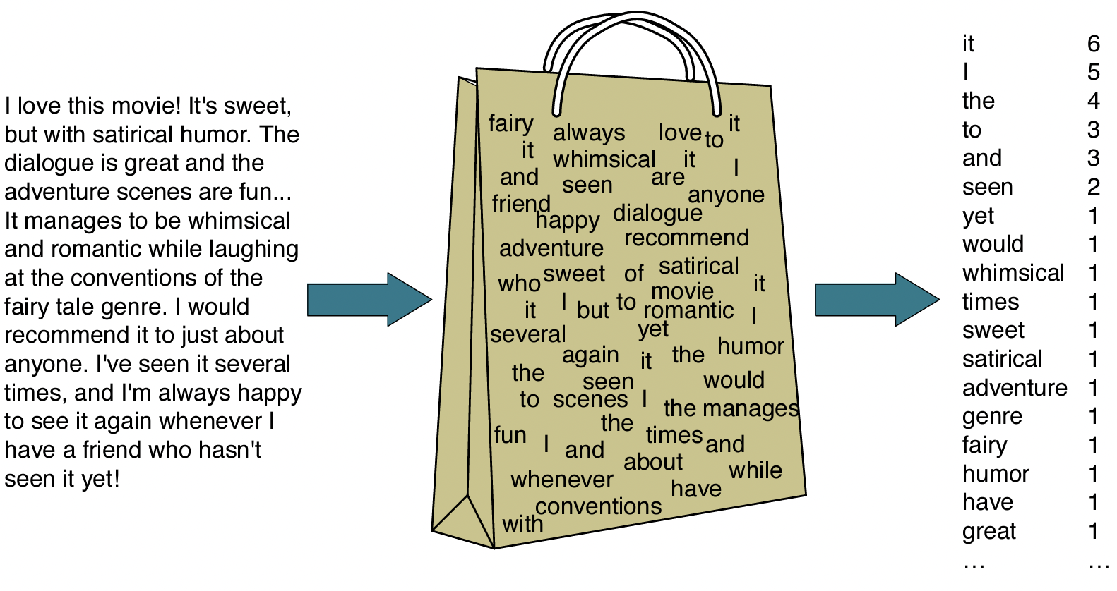
Bag-of-word features
Taken from Martin and Jurafsky 3rd ed.

Slide 13
feature vector to represent the text 'predictable and boring'
Text | Label (Y) | predictable | and | boring | very | few | laughs | short | but | powerful | fun | good
predictable and boring | negative | 1 | 1 | 1
very few laughs | negative |  |  |  | 1 | 1 | 1
short but boring | negative |  |  | 1 |  |  |  | 1 | 1
very very powerful | positive |  |  |  | 2 |  |  |  |  | 1
fun and good good laughs | positive |  | 1 |  |  |  | 1 |  |  |  | 1 | 2
Bag-of-word features or bag of unigram

Slide 14
feature vector to represent the text 'predictable and boring'
Text | Label (Y) | predictable | and | boring | very | few | laughs | short | but | powerful | fun | good
predictable and boring | negative | 1 | 1 | 1
very few laughs | negative |  |  |  | 1 | 1 | 1
short but boring | negative |  |  | 1 |  |  |  | 1 | 1
very very powerful | positive |  |  |  | 1 |  |  |  |  | 1
fun and good good laughs | positive |  | 1 |  |  |  | 1 |  |  |  | 1 | 1
Unigram binary

Slide 15
feature vector to represent the text 'predictable and boring'
Text | Label (Y) | predictable | and | boring | very | few | laughs | short | but | powerful | fun | good
predictable and boring | negative | 1 | 1/2 | 1/2
very few laughs | negative |  |  |  | 1/2 | 1 | 1/2
short but boring | negative |  |  | 1/2 |  |  |  | 1 | 1
very very powerful | positive |  |  |  | 2/2 |  |  |  |  | 1
fun and good good laughs | positive |  | 1/2 |  |  |  | 1/2 |  |  |  | 1 | 2
Unigram TFIDF feature

Slide 16
feature vector to represent the text 'predictable and boring'
Text | Label (Y) | predictable-and | and-boring | very-few | few-laughs | short-but | …
predictable and boring | negative | 1 | 1 |  |  |  | …
very few laughs | negative |  |  | 1 | 1 |  | …
short but boring | negative |  |  |  |  | 1 | …
very very powerful | positive |  |  |  |  |  | …
fun and good good laughs | positive |  |  |  |  |  | …
Bag-of-bigram feature

Slide 17
Text Representation (Features)
Unigram count feature assumes each label has a list of associated keywords. This is a very good baseline feature.
Unigram binary feature is like unigram count feature but ignores the effects of duplicate words.
Unigram TF-IDF feature is like unigram count feature but downweights some of the words that appear in too many documents.
Bigram count feature assumes that we must consider at least two adjacent words to be able to predict the label. This feature is always too sparse i.e. too many zeros in the feature vector.
These features do work well if we have a good amount of data, but we will see more advanced representation called 'word embeddings.' Stay tuned.

Slide 18
Components of ML classifier
Representation - How do we convert from text to a feature vector?
Inference/prediction - How do we compute P(Y|X)?
Training
Objective function
Optimization algorithm for training

Slide 19
Logistic Regression - Inference
Naive Bayes computes P(Y|X) by multiplying up P(x|Y=y) (product of all features x for each label y)
Logistic regression compute P(Y|X) by using sigmoid function (if 2 classes) or softmax function (if > 2 classes)

Slide 20
Consider this model
Text: tweet
Feature: bag-of-word ('against', 'love')+ text length
Label: {positive (1), negative (0)}

Slide 21
Multiply features with parameters and sum up
text |  | 'against' | 'love' | text length
The protester is against the ... |  | 1 | 0 | 100
Weight | bias | 'against' | 'love' | text length
positive | 0.05 | -1 | 2 | -0.0004
score (z) |  | 'against' | 'love' | text length
positive | 0.05 | 1 x - 1 | 0 x -2 | 100 x -0.0004
=-0.99
Compute the unnormalized score (z) by summing up (linear combination) the product between feature and parameter

Slide 22
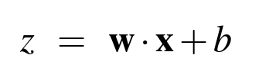
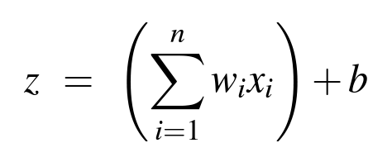
Bias + dot product between w x
 | Feature vector | x₁ | x₂ | x₃
 | x = | 1 | 0 | 100
 | Weight | w₁ | w₂ | w₃
 | w = | -1 | 2 | -0.0004
score (z) | bias+ | dot product = w ⋅ x
z = | 0.05 + | (1 x - 1) + (0 x -2) + (100 x -0.0004)
 | b + | w₁x₁ + w₂x₂ + w₃x₃

Slide 23
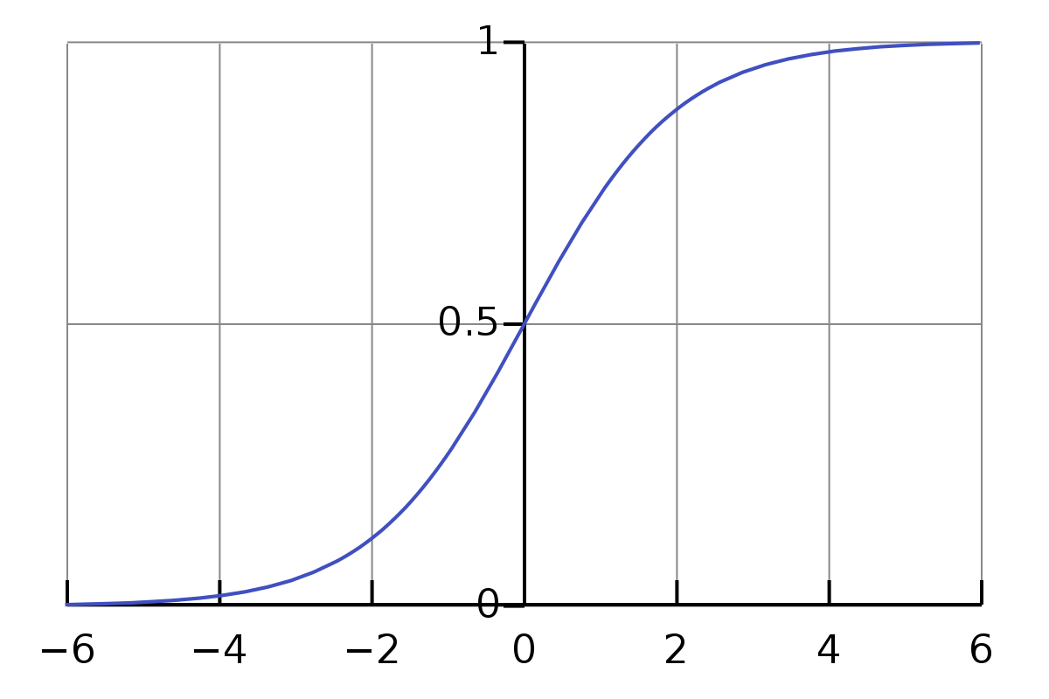
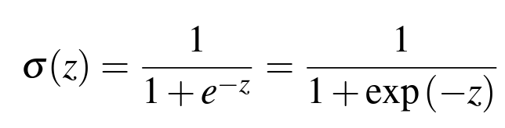
Sigmoid
We convert z into probability P(Y=1|X) by passing z into a sigmoid function (also called logistic function).
e ≈ 2.71828

Slide 24
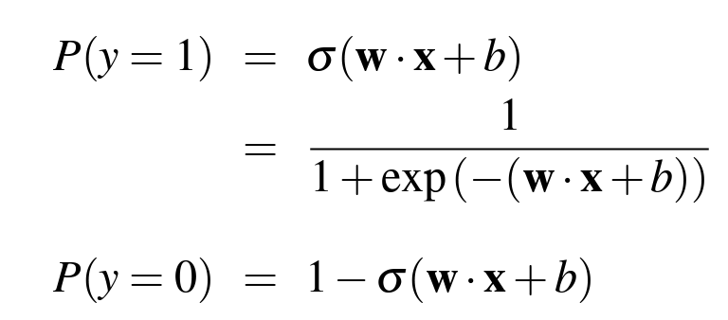
Compute P(Y|X)
Using complementation, if Y is not 1, then Y must be 0.
P(Y=0) = 1 - P(Y=1)

Slide 25
(Binary) Logistic Regression
One instance of the text is represented by a feature vector x = [x₁, x₂, …, x_{n}]
The logistic regression model has a bias term b (also called intercept term) and weight vector w = [w₁, w₂, …, w_{n}]. b and w are the model parameters that need to be learned/trained from the training set.
Bias b represents the score in favor of the positive label regardless of the feature vector.
Each weight w_{i}, represents the score in favor of the positive label associated with each feature x_{i}.
z = unnormalized score computed by bias + the dot product of w and x
The probability of the positive label P(Y=1|X) is computed by passing z into a sigmoid function.

Slide 26
Multiclass Logistic Regression

Slide 27
Multiclass Logistic Regression
Multiclass logistic regression is just like binary logistic regression, but it supports the scenario where classes are > 2.
The idea is the same but we have weight vector for each class. If there are 3 classes, we have three weight vectors. We concatenate these vectors and call them weight matrix.

Slide 28

Multiply features with parameters and sum up
text |  | 'against' | 'love' | text length
The protester is against the ... | x = | 1 | 0 | 100
Weight matrix (W) | bias | 'against' | 'love' | text length
positive | 0.15 | -2 | -1 | 0.0004
negative | -0.2 | 2 | -0.2 | 0.005
neutral | 1 | -1 | 0.4 | -0.00001
score (z) | bias | 'against' | 'love' | text length
positive | 0.15 | 1 x - 2 | 0 x -1 | 100 x 0.0004
negative | -0.2 | 1 x 2 | 0 x -0.2 | 100 x 0.005
neutral | 1 | 1 x -1 | 0 x 0.4 | 100 x -0.00001
Compute the unnormalized score z_{j} for each class j

Slide 29
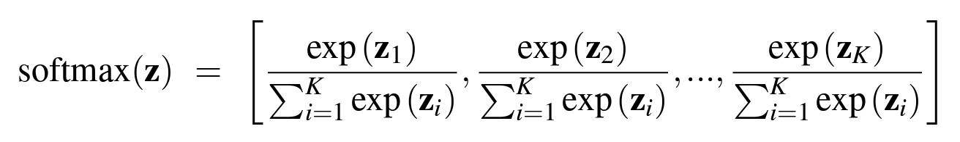
Softmax Function
 | bias | 'against' | 'love' | text length | score (z)
positive | 0.15 | 1 x - 2 | 0 x -1 | 100 x 0.0004 | -1.81
negative | -0.2 | 1 x 2 | 0 x -0.2 | 100 x 0.005 | 2.3
neutral | 1 | 1 x -1 | 0 x 0.4 | 100 x -0.00001 | -0.001
Convert (normalize) z into a probability vector by passing it to softmax function.
 | z | exp(z) | P(Y)
positive | -1.81 | 0.1636541368 | 0.0147
negative | 2.3 | 9.974182455 | 0.8956
neutral | -0.001 | 0.9990004998 | 0.0897

Slide 30
Matrix and Vector

Slide 31
Notes here
https://drive.google.com/file/d/1KjgDhdY9z5THuPfZEYBXjwoEIchYyi0a/view?usp=drive_link

Slide 32
Matrix Multiplication
 | 'against' | 'love' | text length |  |  |  |  | bias
 | -2 | -1 | 0.0004 |  | 1 | 'against' |  | 0.15
z = | 2 | -0.2 | 0.005 | . | 0 | 'love' | + | -0.2
 | -1 | 0.4 | -0.00001 |  | 100 | 'text length |  | 1
 |  | W |  |  | x |  |  | b
 | -1.96 |  | 0.15
z = | 2.5 | + | -0.2
 | -1.001 |  | 1
 |  |  | b
Compute dot product for each row

Slide 33
Matrix Multiplication
 | 'against' | 'love' | text length |  |  |  |  | bias
 | -2 | -1 | 0.0004 |  | 1 | 'against' |  | 0.15
z = | 2 | -0.2 | 0.005 | . | 0 | 'love' | + | -0.2
 | -1 | 0.4 | -0.00001 |  | 100 | 'text length |  | 1
 |  | W |  |  | x |  |  | b
 | -1.96 |  | 0.15
z = | 2.5 | + | -0.2
 | -1.001 |  | 1
 |  |  | b
Compute dot product for each row

Slide 34
Matrix Multiplication
 | 'against' | 'love' | text length |  |  |  |  | bias
 | -2 | -1 | 0.0004 |  | 1 | 'against' |  | 0.15
z = | 2 | -0.2 | 0.005 | . | 0 | 'love' | + | -0.2
 | -1 | 0.4 | -0.00001 |  | 100 | 'text length |  | 1
 |  | W |  |  | x |  |  | b
 | -1.96 |  | 0.15
z = | 2.5 | + | -0.2
 | -1.001 |  | 1
 |  |  | b
Compute dot product for each row

Slide 35
Matrix Multiplication
 | 'against' | 'love' | text length |  |  |  |  | bias
 | -2 | -1 | 0.0004 |  | 1 | 'against' |  | 0.15
z = | 2 | -0.2 | 0.005 | . | 0 | 'love' | + | -0.2
 | -1 | 0.4 | -0.00001 |  | 100 | 'text length |  | 1
 |  | W |  |  | x |  |  | b
 | -1.96 |  | 0.15
z = | 2.5 | + | -0.2
 | -1.001 |  | 1
 |  |  | b
Compute dot product for each row

Slide 36
Matrix Multiplication
 | 'against' | 'love' | text length |  |  |  |  | bias
 | -2 | -1 | 0.0004 |  | 1 | 'against' |  | 0.15
z = | 2 | -0.2 | 0.005 | . | 0 | 'love' | + | -0.2
 | -1 | 0.4 | -0.00001 |  | 100 | 'text length |  | 1
 |  | W |  |  | x |  |  | b
 | -1.96 |  | 0.15
z = | 2.5 | + | -0.2
 | -1.001 |  | 1
 |  |  | b
 | -1.81
z = | 2.3
 | -0.001
Compute dot product for each row
Add the result with the bias vector

Slide 37
Matrix Multiplication
 | 'against' | 'love' | text length |  |  |  |  | bias
 | -2 | -1 | 0.0004 |  | 1 | 'against' |  | 0.15
z = | 2 | -0.2 | 0.005 | . | 0 | 'love' | + | -0.2
 | -1 | 0.4 | -0.00001 |  | 100 | 'text length |  | 1
 |  | W |  |  | x |  |  | b
 | -1.96 |  | 0.15
z = | 2.5 | + | -0.2
 | -1.001 |  | 1
 |  |  | b
 | -1.81
z = | 2.3
 | -0.001
Compute dot product for each row
Add the result with the bias vector
Then softmax vector z

Slide 38
Inference for multinomial logistic regression
Same as binary logistic regression. One instance of the text is represented by a feature vector x = [x₁, x₂, …, x_{n}] if we use n features.
The logistic regression model has a bias vector b and weight matrix W (of size k x n if we have k classes.,. b and W are the model parameters that need to be learned/trained from the training set.
b_{i} is the bias for the class i. If b_{i} > 0, then class i is more probable.
w_{ij} is the weight for class i feature j. (row i column j in W) If w_{ij} > 0 and x_{j} > 0_, then class i is more probable.
The probability P(Y|x) is computed as follows: y = softmax(Wx + b)

Slide 39
Components of ML classifier
Representation - How do we convert from text to a feature vector?
Inference/prediction - How do we compute P(Y|X)?
Training
Objective function
Optimization algorithm for training

Slide 40
Where do W and b come from?
We want W and b that produce P(Y|x) to be the most similar to the actual label in the training set. So we need to measure the similarity, which is called loss function or cost function.
If loss is high, the model is bad.
If loss is low, the model is good.
An optimization algorithm is an algorithm that helps minimize loss function. (optimize = หาค่าที่เหมาะสมที่สุด ถึงแม้ว่าสถานการณ์ต้องมีการได้อย่างเสียอย่างเกิดขึ้น)

Slide 41
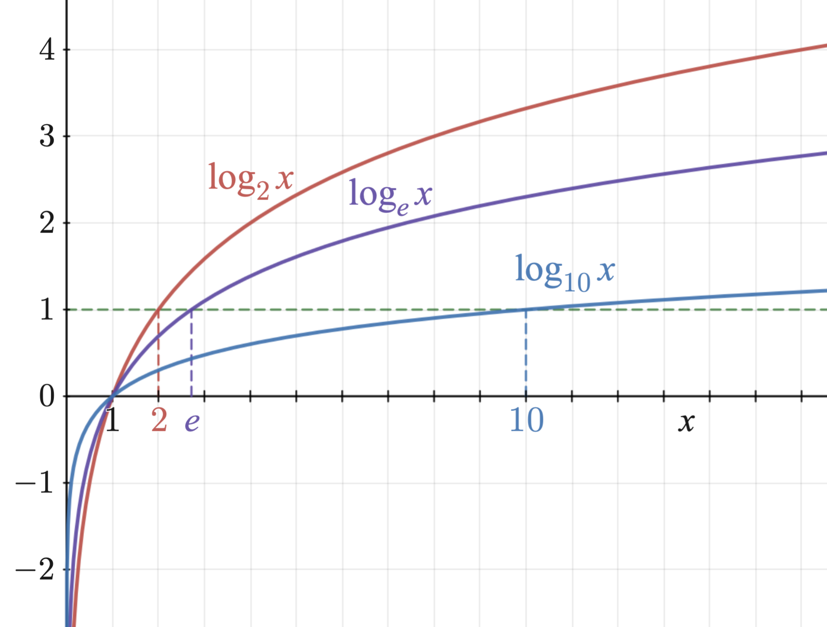
Aside: Logarithm
A logarithm log(x) is a mathematical function that
'compresses' the range of x if x > 1
'expands' the range of x if x < 1.
A logarithm of different base has different shapes. ln (natural logarithm) is a logarithm with base e ≈ 2.71828
In machine learning, log is assumed to have base e.

Slide 42
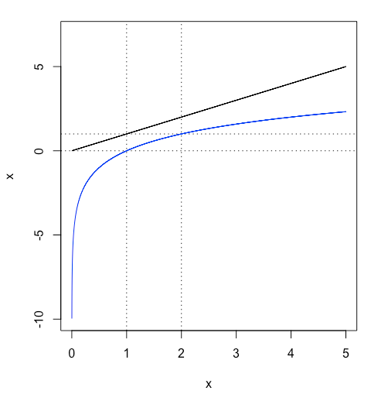
Aside: Logarithm probability
0 < P(x) < 1 so the value can be hard to read and calculate.
Log probability: -Inf < log(P(x)) < 0 since log compresses the range. A small change in P(x) results in large change in log(P(x))
log(0.001) = -6.907…
log(0.002) = -6.214…
log(0.020) = -3.912…

Slide 43
Measuring the deviation from gold standard
Intuitively, we want the model parameters W and b such that the accuracy is the highest possible. But the accuracy is not a smooth function, so it is not suitable.
Instead, we use If y is the correct label for text x, then we want W and b such that P(Y=y|x, W, b) to be very close to 1. That means log(P(Y=y|x, W, b) should be close to log(1) = 0 if the model is good.
Remember 0 < P(Y|X) < 1 and -Inf < log P(Y|X) < 0

Slide 44
Computing cross-entropy loss
Example https://docs.google.com/spreadsheets/d/1W2ss3QwECw1g8W087vZ6Pqnjcn7iZ9jPZxALMkHXmv8/edit?usp=sharing

Slide 45
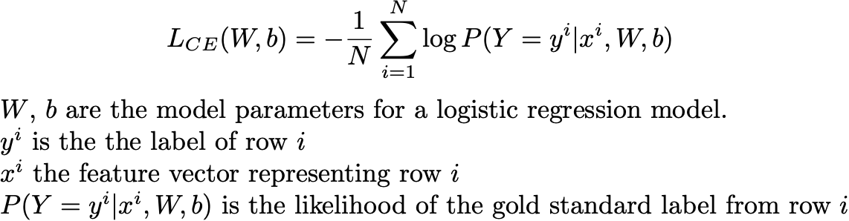
Cross-entropy Loss
Notes:
$$L_{CE}(W,b) = -\frac{1}{N}\sum_{i=1}^{N} \log P(Y=y^i|x^i, W, b)$$
$W$, $b$ are the model parameters for a logistic regression model.
$y^i$ is the the label of row $i$
$x^i$ the feature vector representing row $i$
$P(Y=y^i|x^i, W, b)$ is the likelihood of the gold standard label from row $i$

Slide 46
Components of ML classifier
Representation - How do we convert from text to a feature vector?
Inference/prediction - How do we compute P(Y|X)?
Training
Objective function
Optimization algorithm for training

Slide 47
Optimization algorithm
Our goal is to find the optimal W and b which maximizes the probability (likelihood) of the label in the training set. = we want to minimize the loss function (e.g. cross-entropy loss)
Gradient descent is an optimization algorithm that is the base for many modern optimization algorithms that we will see later in this class.

Slide 48
Calculus Review

Slide 49
Notes here

Slide 50
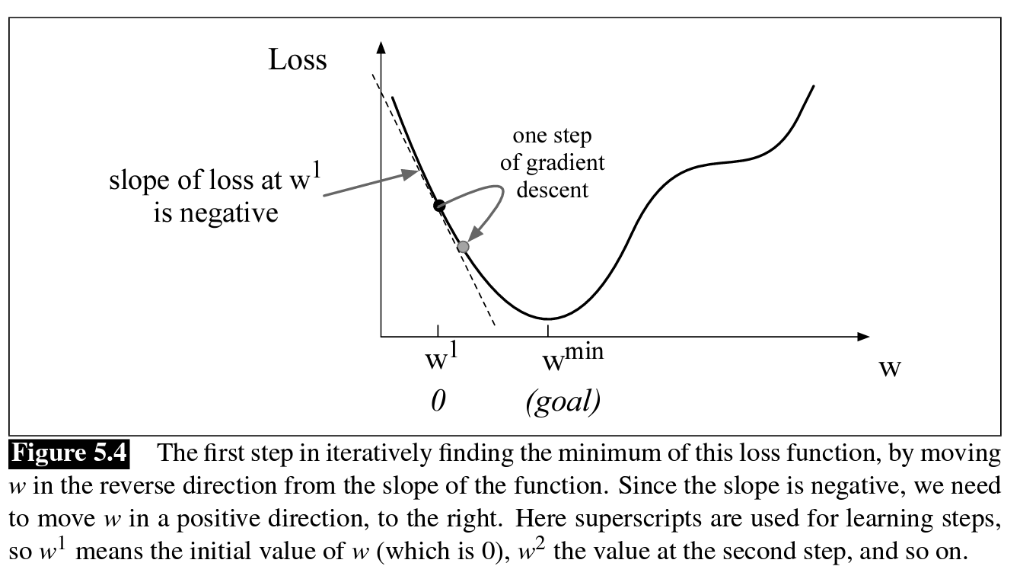
Gradient is the direction where the slope is steepest

Slide 51
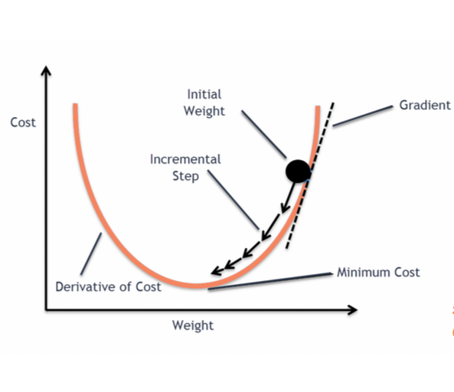
Gradient Descent
การใช้ gradient (ซึ่งมาจากการ diff objective/loss function) นำมาปรับ parameter เพื่อให้ loss function ต่ำลง
https://blog.clairvoyantsoft.com/the-ascent-of-gradient-descent-23356390836f

Slide 52
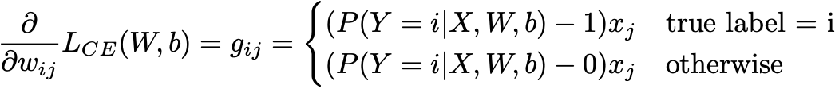
We compute gradient for each w_{ij}
Notes:
\frac{\partial}{\partial w_{ij}}L_{CE}(W,b) = g_{ij} =
\begin{cases}
(P(Y=i|X,W,b) - 1)x_j & \text{true label = i} \\
(P(Y=i|X,W,b) - 0)x_j & \text{otherwise}
\end{cases}

Slide 53
Update equation for w_{ij} for stochastic gradient
new w_{ij} = old w_{ij} - η g_{ij}
If the probability for the true label is 1, then do nothing. (it's perfect)
If the probability for the true label is too low, then increase the weight.
If the probability for the false label is 0, then do nothing. (it's perfect)
If the probability for the false label is too high, then decrease the weight.
Notes:
\frac{\partial}{\partial w_{ij}}L_{CE}(W,b) = g_{ij} =
\begin{cases}
(P(Y=i|X,W,b) - 1)x_j & \text{true label = i} \\
(P(Y=i|X,W,b) - 0)x_j & \text{otherwise}
\end{cases}

Slide 54
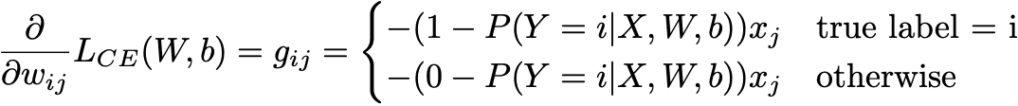
Compute the prediction error and then correct it
Notes:
\frac{\partial}{\partial w_{ij}}L_{CE}(W,b) = g_{ij} =
\begin{cases}
(P(Y=i|X,W,b) - 1)x_j & \text{true label = i} \\
(P(Y=i|X,W,b) - 0)x_j & \text{otherwise}
\end{cases}

Slide 55
Stochastic Gradient Algorithm
Repeat until OK for x, y in training_set: compute P(Y|x) update w_{ij} = old w_{ij} - η g_{ij}

Slide 56
Batch Stochastic Gradient Descent Algorithm
Repeat until OK total_g_{ij} = 0 for x, y in training_set: compute P(Y|x) and g_{ij} total_g_{ij} += g_{ij} update w_{ij} = old w_{ij} - η (total_g_{ij} / N)

Slide 57
Batch vs Stochastic Gradient
Batch gradient descent uses the entire dataset to calculate the gradients at each step. The gradient is more accurate because we average across many training samples.
+ The process is stable because of averaging across the training set.
- This can be computationally expensive when the dataset is large.
Stochastic gradient descent uses a single data point to calculate the gradients at each step.
+ Computing gradient is efficient based on one single point at a time.
- The process is less stable because some data points are bad and give us a wrong direction to update.

Slide 58
Interpreting Logistic Regression

Slide 59
Interpreting models
"Often we want to know more than just the correct classification of an observation. We want to know why the classifier made the decision it did. That is, we want our decision to be interpretable. Interpretability can be hard to define strictly, but the core idea is that as humans we should know why our algorithms reach the conclusions they do. Because the features to logistic regression are often human-designed, one way to understand a classifier’s decision is to understand the role each feature plays in the decision." (Martin and Jurafsky, 3rd edition)

Slide 60
Example: Examine heavy weights of each class
 | b | predictable | boring | very | few | laughs | short | powerful | fun | good
negative | 0.20 | 0.14 | 0.29 | 0.10 | 0.20 | -0.34 | -0.10 | -0.10 | -0.40 | -0.20
positive | -0.4 | -0.20 | -1.00 | 0.01 | 0.20 | 0.20 | -0.40 | 0.20 | 1.10 | 0.40
neutral | 1 | -0.50 | -2.30 | 0.50 | 0.10 | 0.01 | 0.30 | -0.40 | 0.10 | 0.20

Slide 61
How do we develop a text classifier on a real dataset?

Slide 62
Scikit-learn (sklearn)
Scikit-learn (also known as sklearn) is a free and open-source Python library for machine learning. It provides a range of supervised and unsupervised learning algorithms in Python. It also provides preprocessing tools, feature extraction tools, and evaluation tools.
The library is very well-documented and actively maintained by a strong open-source community.

Slide 63
Demo
Naive Bayes and logistic regression on sklearn.
For the most part, you can ask ChatGPT for the full code.
Let's go!

